Slide 1




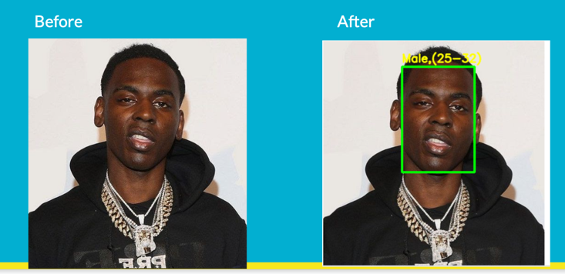
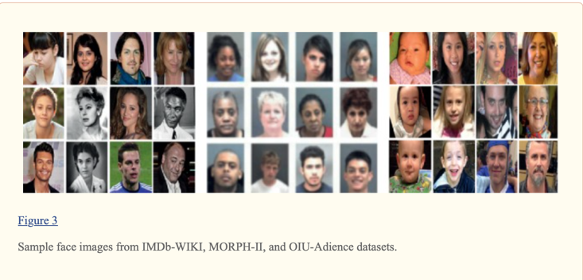
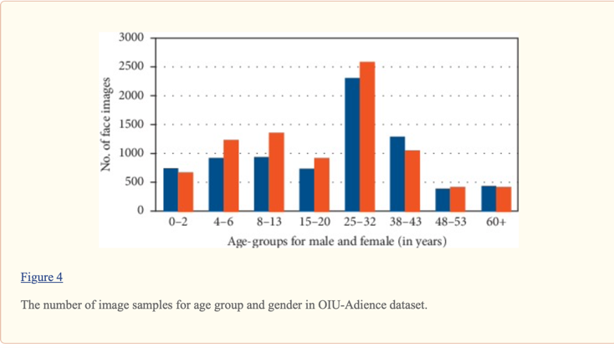
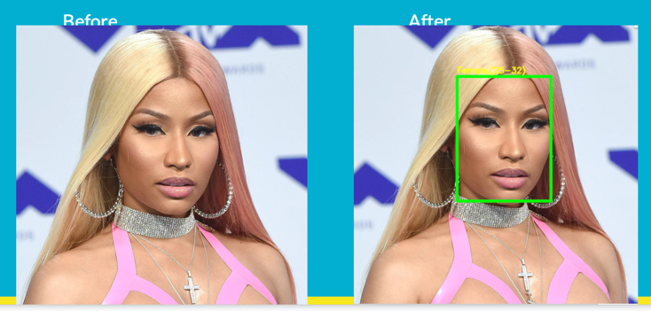
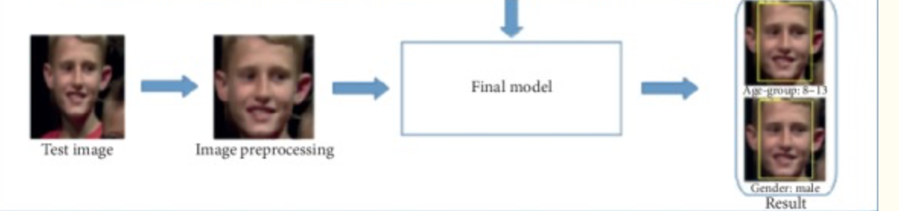
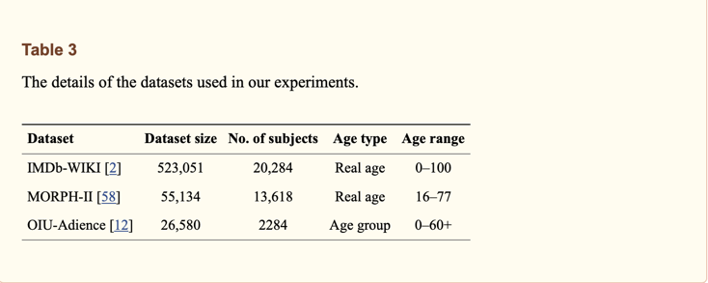
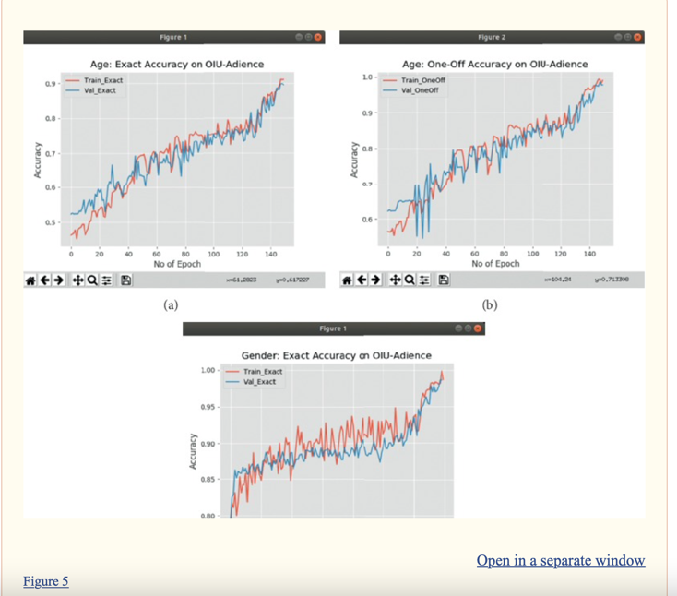
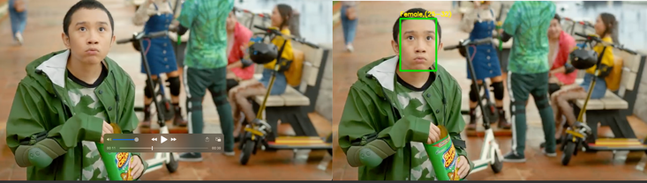
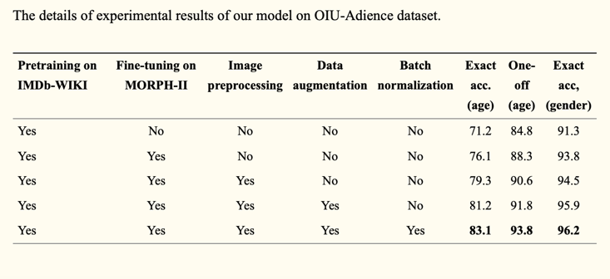
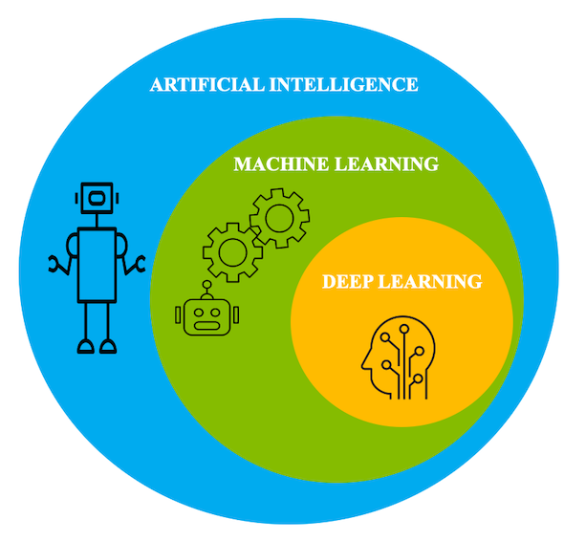
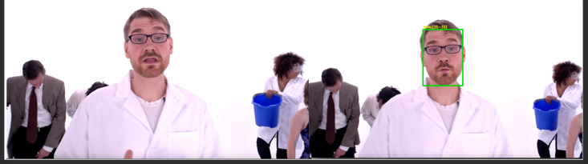
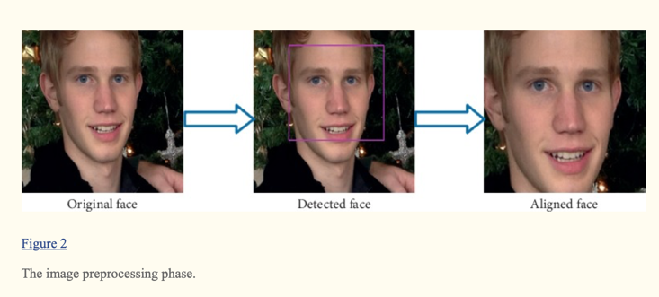
Face, Age and Gender Detection using Deep Learning by Chriss Jordan Oboa
Introduction
Data processing
Results
What is face, Age, and genre detection? Well, it is a program which is capable to take an image of a person, understand where the face of the person and then pass it through a Machine learning and Deep learning algorithm to detect the gender and the approximate age of that person; it's as simple as that.
There are three steps present in this process we used for this project.
So, this is how it goes in a simple explanation.
Step one
Step one is simply doing face reduction. This step is reading the image and passing it to the face detectors. Once the face is detected and there's a small pre-processing stage in which localize and lock the face in to start pre-processing.
Step two
Step two is the pre-processing stage: some sort of processing on the image and once that is done then you're sending it to the detector module which is going to detect the age and gender of the person.
Step Three
This step is the part where Age and Gender detection receives the pre-processed image, then runs it into the age and detector frame in which uses the pre-trained .
Unprocessed and processed images
Dataset Description
For the dataset, we used two developed models one based on Age and one on Genre found on YouTube provided by Misbah Mohammed. They were developed by researchers who deployed or made these models, shipped through different types of images which they collected, and they also had their database. Those images collected are completely different. They had a different brightness, different profile, were taken on a different day, different saturation, different person and more which make those images have different property levels. Those models were pre-trained and have proven to be efficient during the process of this project.
Unprocessed and processed videos
Deep Learning
What is this Face, Age, and Gender detection program doing? This program takes the image and goes through a face detection system. Then, there is this function called “face box” implemented that has the role of opening and reading through the face detector file and getting the dimensions or the director the location of the face in the image and it takes that information and supplies it to the pre-trained Gender and Age detection module.
How does this work?

